Slide 1


Slide 2
The Indices of HOI
Process Variables (Actionable)

Slide 3

Affordability Index
The affordability index is developed to measure the proportion of income spent on housing and transportation. The index of affordability is calculated by combining housing and transportation costs in a neighborhood and dividing that number by income.

Slide 4
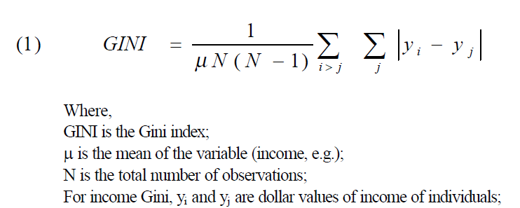
Income Inequality (GINI) Index
the GINI coefficient (also known as the index of income concentration).
Measures inequality of income.
Measures how homogeneous or diversity of actual earned income by neighborhood (0 is homogeneous and 10 means more diversity in income earning positions.

Slide 5
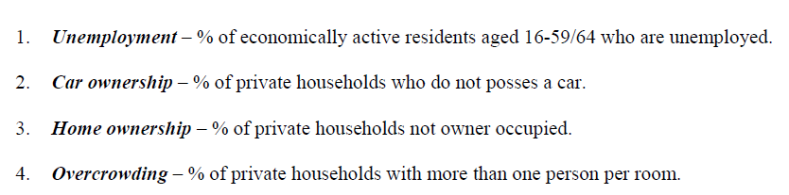
Townsend Dep. Index *
Townsend deprivation index is a measure of material deprivation. According to Townsend, “Material deprivation entails the lack of goods, services, resources, amenities and physical environment which are customary, or at least widely approved in the society under consideration.
* The four variables were combined into one indicator using principal component analysis (using the natural log of the variables)

Slide 6

Job Participation Index
Job Participation Rate is the percentage of individuals 16-64 years of age in the active labor force. The job participation rate is often used by economics as an indicator for economic development and growth.

Slide 7

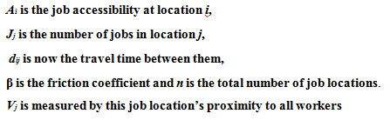
Employment Access Index
Poor job access leads to difficulties in job search or job retention and, consequently, to poverty and socioeconomic disadvantages
Employment accessibility index: you may have a workforce but how accessible are they to the potential jobs --- how far are you (distance) from a potential job. In other words, the index is based on jobs and distance decay function
Ownership of a vehicle plays a function

Slide 8
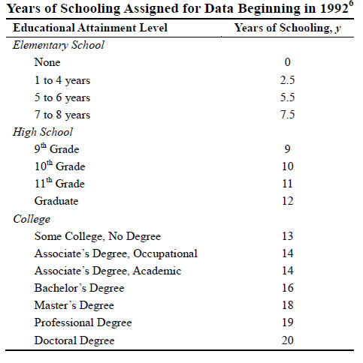
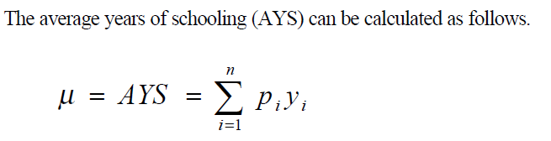

Education Index
The majority of the empirical literature uses average years of education as a proxy of the human capital stock
higher level of human capital stock leads to faster technological development and ultimately higher growth rates
Preschool through doctorate (this index is weighted based upon how far you have advanced in education)
Higher the number the higher average number of schooling in the area

Slide 9

Population Churning Index
Population churning rates relate the combined inflow and outflow for an area to the resident population. The rates can provide a useful measure of the potential disruption to local services caused by migration into and out of the Census tract.

Slide 10
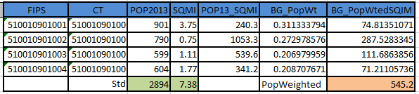
Population-Weighted Density Index
Weighted density is to capture the density at which the average person lives (aka Dysmetric).
It is necessary to differential between urban and rural in the model

Slide 11
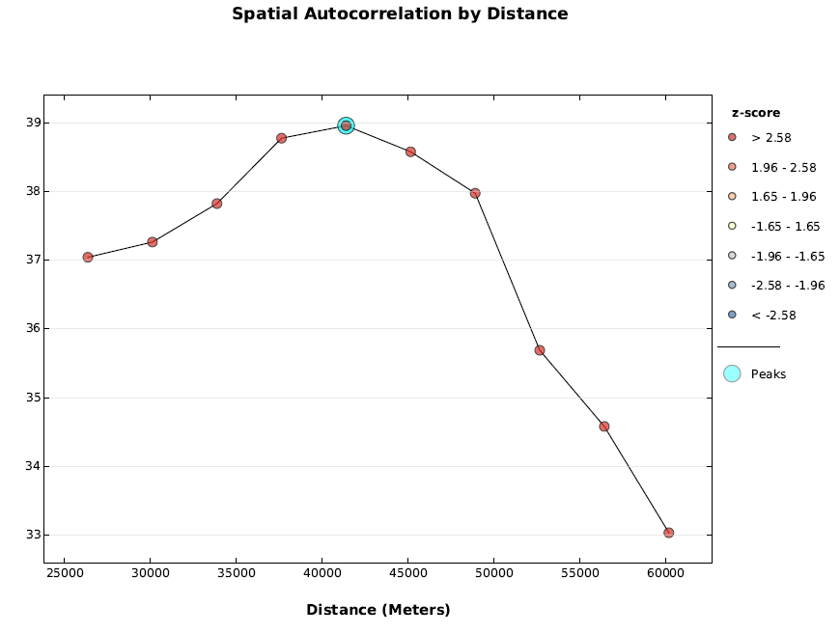
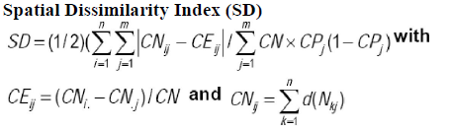
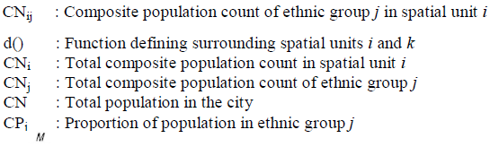
Segregation Index (Spatial Dissimilarity)
Calculates a segregation or dissimilarity index that measures how different the population composition of a subarea (CT) is from the population composition of the State as a whole

Slide 12
Food Accessibility Index
Limited access to supermarkets, supercenters, grocery stores, or other sources of healthy and affordable food may make it harder for some Americans to eat a healthy diet
Low access was measured as living far from a supermarket, where 1 mile was used in urban areas and 10 miles was used in rural areas to demarcate those who are far from a supermarket.
The index was calculated based on the share (proportion of the target population) of the population that fit the USDA criteria rather than using the binary indicator.

Slide 13

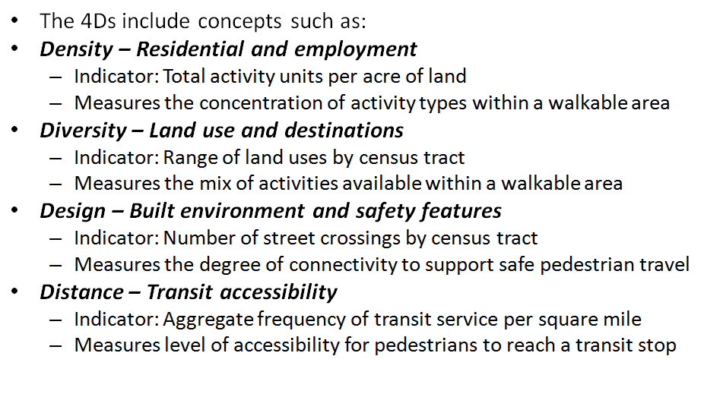
Walkability Index (4Ds)
Methodology was adopted from International Physical Activity and the Environment Network (IPEN)
* Design of the built environment
Land use diversity
Distance to transit
Residential and employment density
* Variable was weighted twice

Slide 14
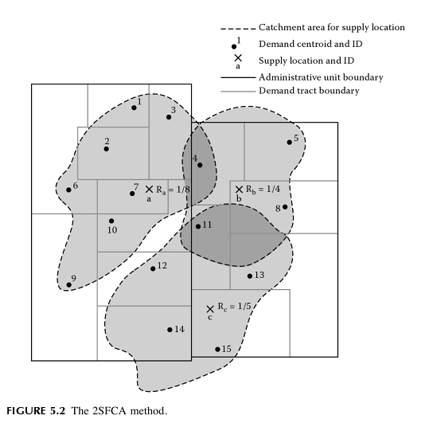
Access to Care (2SFCA)
It first assesses “physician availability” at the physicians' (supply) locations as the ratio of physicians to their surrounding population (i.e., within a threshold travel time from the physicians)
It sums up the ratios (i.e., physician availability derived in the first step) around (i.e., within the same threshold travel time from) each residential (demand) location. Based on Population-weighted centriod
% of Healthcare Uninsured Population was also combined with the FTEs to form the indicator

Slide 15
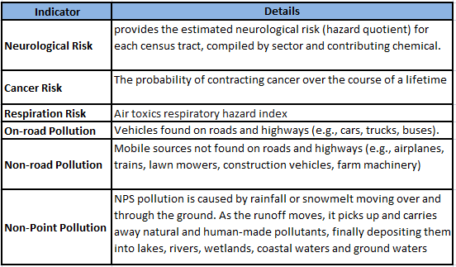
Environmental Quality Index (EPA) *
National-Scale Air Toxics Assessment (NATA) provides estimates of the risk of cancer and other serious health effects from breathing (inhaling) air toxics in order to inform both national and more localized efforts to identify and prioritize air toxics, emission source types and locations which are of greatest potential concern in terms of contributing to population risk
* The six databases were transformed into one indicator using principal component analysis

